Slide 1
English II
Mrs. Cooper’s
Brief explanation of frequently used websites

Slide 2
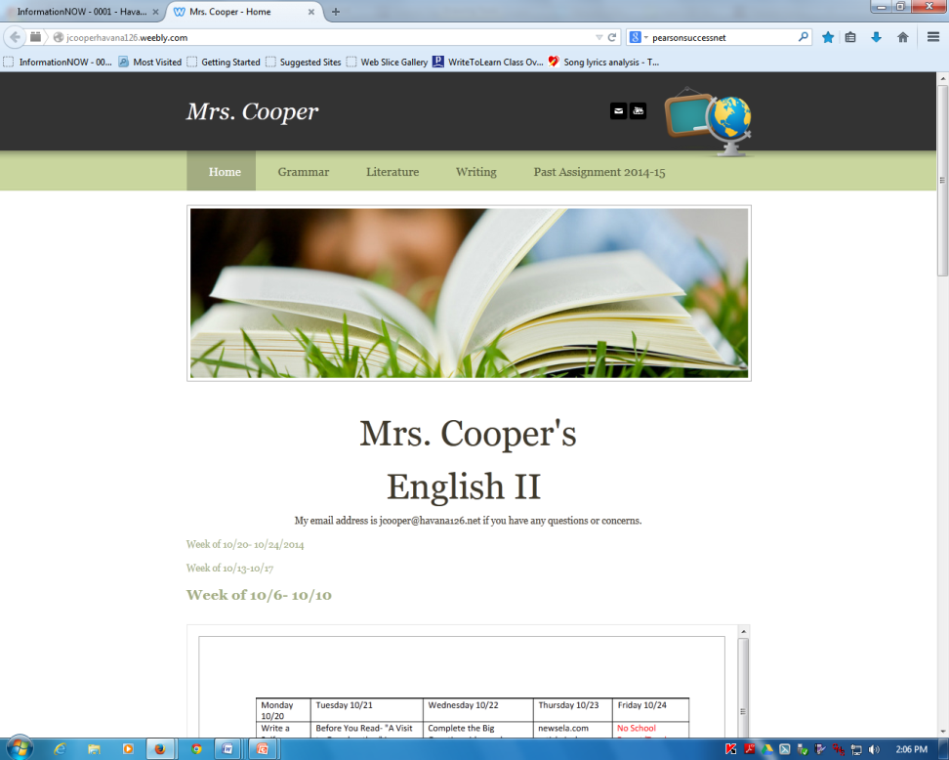
Mrs. Cooper’s Web Page
Students are to access my webpage each day at the beginning of the hour.
This is the best way for them to stay organized and know exactly what they are to be working on.
The previous day’s assignments are due the next day unless stated.
I hyperlink the websites they are to visit or worksheets that I want them to complete.

Slide 3

newsela.com
Each Thursday newsela.com is due. The students are given a choice of at least 5 articles each week to choose from. They read the article and take a quiz. If they so desire, they can initially read the article at a lower reading level then read it at the highest level before taking the quiz over the article. If they do not receive the score they desire, they can read as many articles and take as many quizzes as they like until they are satisfied with the grade they receive for the week.

Slide 4
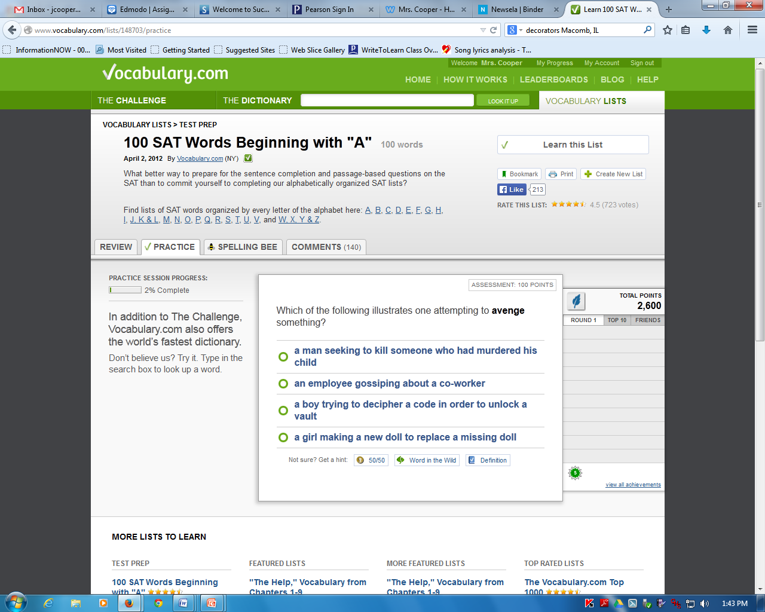
vocabulary.com
Students are encouraged to increase their vocabulary by using vocabulary.com
On this site they are able to compete with other classes, other schools, etc.
We do not use this website weekly, but the students can access it at anytime on their own. Many students have chosen to rise to the challenge.

Slide 5
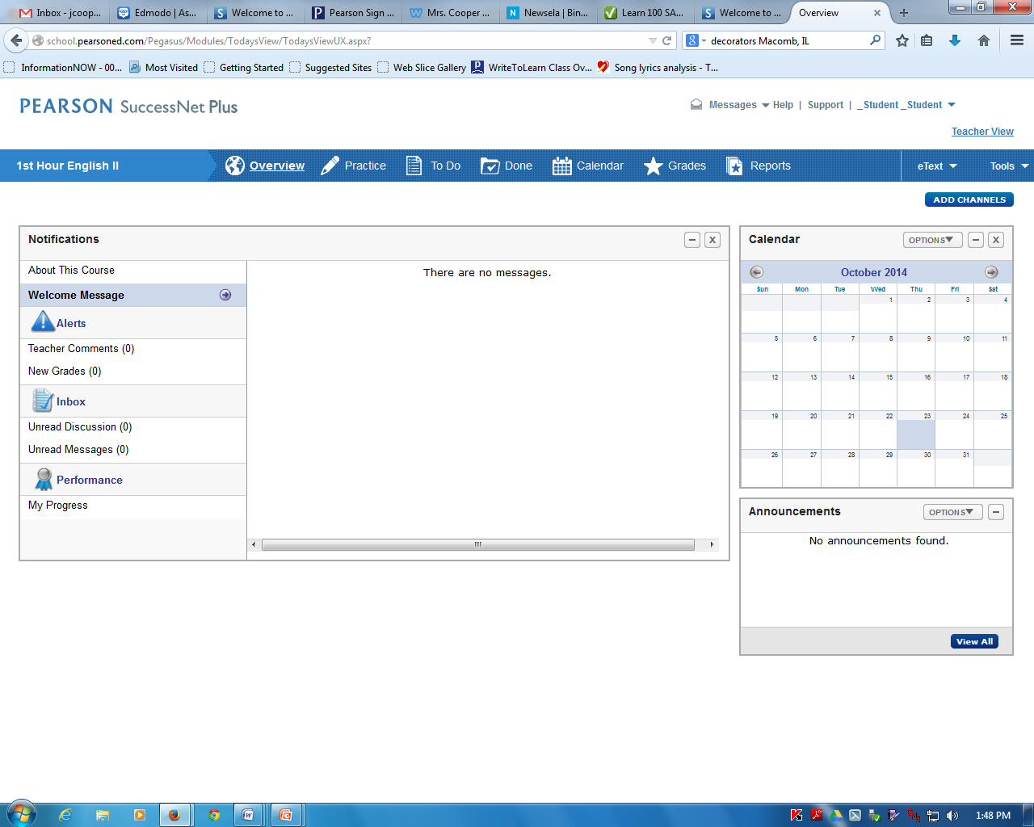
successnetplus.com
This website is essentially our grammar and writing curriculum.
In successnetplus, the students take a diagnostic test to discover what they know about a particular grammar concept. Based upon the results of their diagnostic test, they are assigned individualized lessons for the concepts that they haven’t yet mastered.
This is also the writing curriculum. Students are assigned essays and the computer program gives them guided feedback on ways to improve their essay and essay score.

Slide 6

pearsonrealize.com/community/home
This is our literature curriculum.
Each short story has a before you read lesson, while you read lesson, and after you read lesson. Each story has videos, worksheets, questions to help guide the reading, and additional supplemental materials.

Slide 7
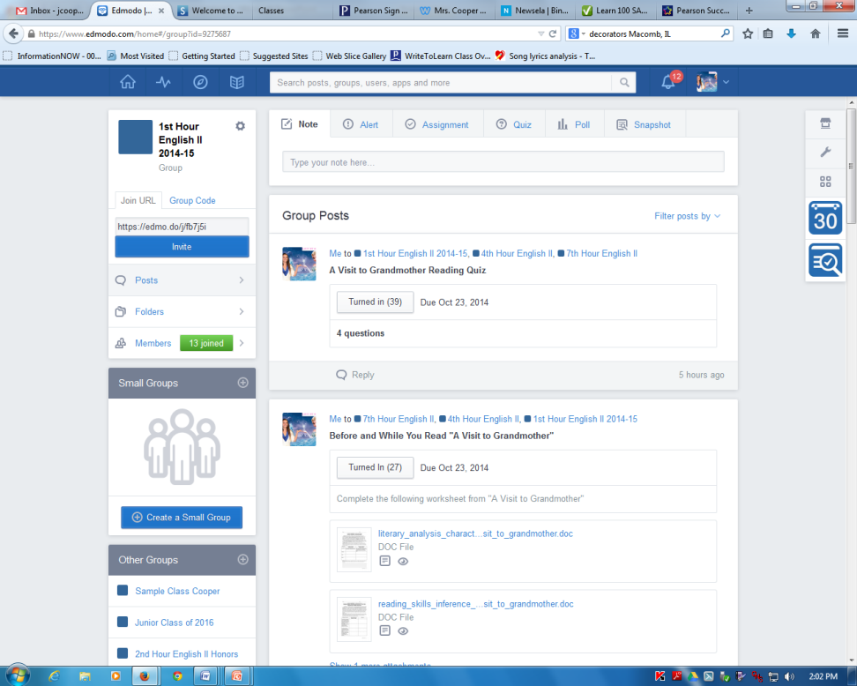
edmodo.com
This is where students access and turn in their worksheets.
They take quizzes and tests and receive immediate results upon submitting their test.

Slide 8
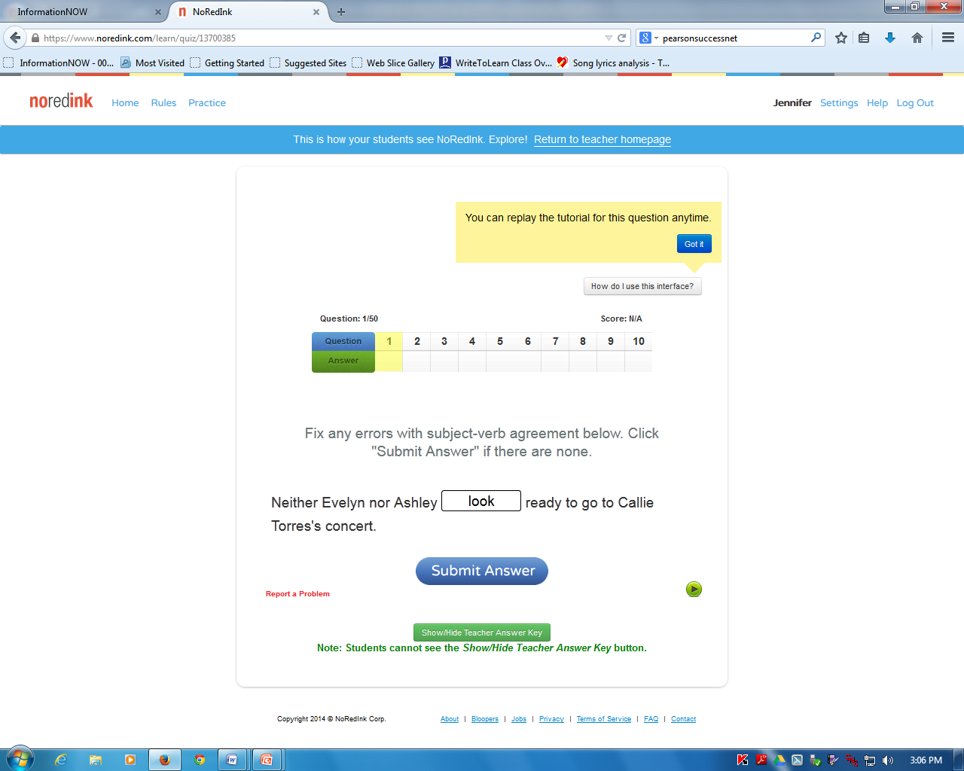
noredink.com
This website is a grammar website that gives the students additional practice on whichever concept we are currently studying.
The questions are individualized based upon the student’s interests.

