Slide 1
Sentence Structure
•••••••••••••••••••••••••••••••••••••••••••••
English honors II: Mrs. Coopers
Kalin Gunter

Slide 2
1. Write a sentence using a strong action verb
Description: Using a less generic verb allows you to add a little Flare to your sentence.
Ex: He clutched his arm.

Slide 3
2. Ask a question
Description: Use a question mark (?) This can be a point to use a new concept.
Ex: Have you eaten yet?

Slide 4
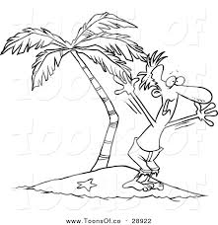
Use an exclamatory sentence
Description: Using an exclamatory mark (!) makes your sentence sound exciting.
EX: He was screaming for help!

Slide 5
Open with and adverb
Description: Adverbs, typically ending with an - ly, describe anything but a noun. Use a comma directly after it.
Ex: Impatiently, she waited for him to hurry up.

Slide 6
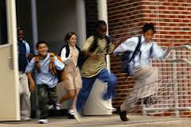
Open with a prepositional phrase
Description: Prepositional phrases show the relationship to the part of the sentence.
Ex: After the bell rang, students left the building.

Slide 7
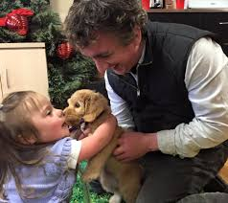
Write a sentence in which a verb precedes the subject
Description: This is where the verb is at the beginning of the sentence.
Ex: Here is the puppy you wanted.

Slide 8
Write an example of dialog
Description: Dialog is a conversation within a group of two or more people.
Ex: “Betty, its so nice to see you!” Margret exclaimed as her old friend sat at the table. “Yes, so great hat you’re back in town,” AJ, her ex, agreed.

Slide 9
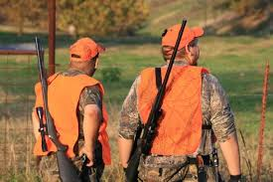
Write a sentence that uses apposition
Description: Appositions are nouns (or pronouns) that follow another noun to help describe it.
Ex: We, Havana Ducks, love to go hunting. (‘We’ is describing Havana Ducks)

Slide 10
Write a sentence with an adverbial clause
Description: Adverbial clauses are just prepositional phrases that are used to modify a verb, adjective, or another adverb.
Ex: With great difficulty, she signed the release papers.

Slide 11
Write a sentence that uses structure in words, phrases clauses or sentences
Description: Using this technique seems to make words and connected subjects flow smoother and sounds more intelligent. It keeps sentences from becoming choppy.
Ex: Maria, captain of the cheer squad, BlueBird Girl Scout leader, and an amazing student, broke her leg the other day; now, she's in the hospital.

Slide 12
Write a sentence that opens with an adjective
Description: An adjective is what modifies nouns and pronouns.
Ex: Green eggs and ham are Audrey's favorite foods.

Slide 13
Write a sentence that opens with an adjective phrase
Description: Adjective phrases modify nouns or pronouns.
Ex: At a great expense, she bought the house.

Slide 14
Write a sentence that opens with a present infinitive
Description: An infinitive is a verb form that usually begins with ‘to.’ It can be used as a noun, adjective or adverb.
Ex: To leave his love would be a disgrace to his heart. (Lol)

Slide 15
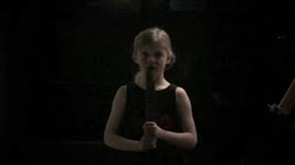
Write a sentence that opens with a present participle
Description: This is a present verb form with the ending –ing. It can be used as an adjective or part of a verb phrase.
Ex: Laughing children creep her out because she lives alone.

Slide 16
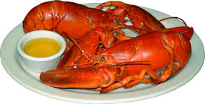
Write a sentence that opens with a past participle
Definition: A past participle is a past verb form that ends with –d or –ed. It is used as a verb/adjective.
Ex: Steamed lobster is amazing.

Slide 17
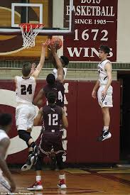
Write a sentence that opens with a verb
Description: Verbs show actions or occurrences.
Ex: Leap, Jeff, leap!

Slide 18
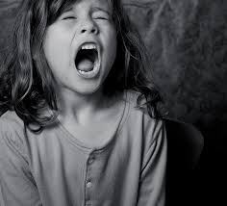
Write a sentence that opens with a present gerund
Description: Gerunds are verbs that end with –ing. They serve as nouns.
Ex: Screaming is extremely annoying.

Slide 19
Write a sentence that uses a restrictive adjective clause
Description: A restrictive adjective clause is essential to the meaning of a sentence and is not set off my commas.
Ex: The puppy in the cardboard box was not injured.

Slide 20
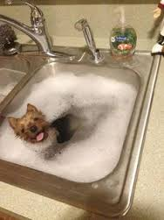
Write a sentence that uses a non-restrictive clause
Description: The clause can be taken out but it will not change the meaning of the sentence.
Ex: My cute puppy, who is hyperactive, had to take a bath today.

Slide 21
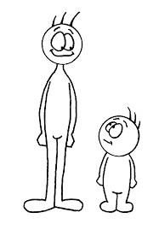
Write a sentence that starts with a noun clause
Description: Noun clauses are subordinate parts of a sentence that can start with- That, whether, why or which.
Ex: Whether they are big or small, a persons a person, no matter how tall.

Slide 22
Write a compound sentence using a comma and FANBOYS
Description: A compound sentence can sometimes use a comma and a conjunction such as- for, and, nor, but, or, yet, and so to make two sentences one.
Ex: She got the blue umbrella for me, but she gave the green one to Amber.

Slide 23
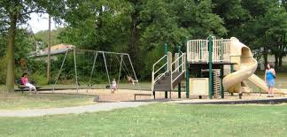
Write a compound sentence with a semicolon and no conjunction
Description: Semicolons can also be used to make two sentences one.
Ex: I went to the park; Jeff, to the mall.

Slide 24
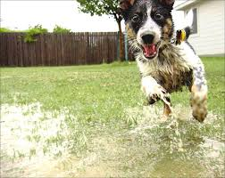
Write a sentence using a semicolon before coordinating conjunctions
Description: When commas are already in place, this technique is used.
Ex: The dog ran, played in the rain and barked all day; the cat slept the entire time.

Slide 25
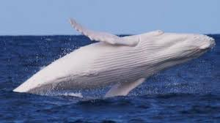
Write a sentence using a semicolon before and a comma after connectives
Description: These kinds of sentences can, sometimes, use a comma(s) and connectives.
Ex: The tourists gazed at the great, white whale in awe; then, they snapped pictures of it excitedly.

Slide 26
Write a sentence that contains elliptical construction
Description: Elliptical phrases or clauses withhold words, yet the sentence still makes sense.
Ex: The boy is stronger than I.

Slide 27
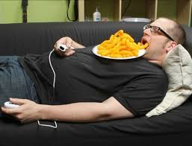
Write a sentence that uses parenthetical expression between the subject and the verb
Description: These kinds of sentences have additional information or related remarks that are linked by commas.
Ex: Lucas, according to his mother, is extremely lazy and not well kept.

Slide 28
Write a compound sentence that uses a colon
Description: The sentence behind the colon explains the first sentence. It is also capitalized.
Ex: He talked to Heather for hours: Heather is his girlfriend.

Slide 29
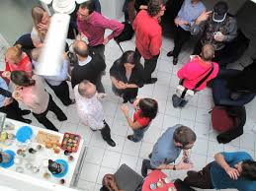
Write a sentence with items in a series that require the use of a semicolon
Description: This type sentence is grammatically correct and breaks up the information correctly.
Ex: I ran into Lara, who is an old high school friend; Ben; and Jake, who I don’t know.

